Slide 1


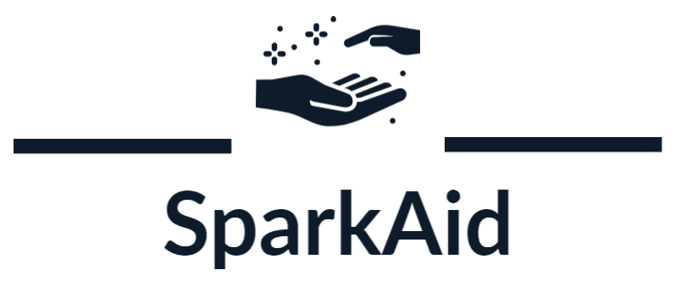
HOMECODERZ
EMPOWERING HUMANITY,IGNITING AID,UNITING RESOURCES

Slide 2





HOMECODERZ
Meet Our Team
Ankit Gupta
Aneerban Saha
Sameer Madhav D.
Ankit Kumar

Slide 3
HOMECODERZ
Problem Statement:
Platform for Donations and Philanthropy Tracking
In the realm of philanthropy and charitable donations, transparency, accountability, and trust are paramount for both donors and beneficiaries. Developing a secure and transparent platform that effectively tracks and manages donations, ensuring that funds reach intended causes and demonstrating their impact, is essential. The challenge in this hackathon is to design and build an innovative, transparent platform that enhances security, and traceability in the domain of donations and philanthropy.

Slide 4
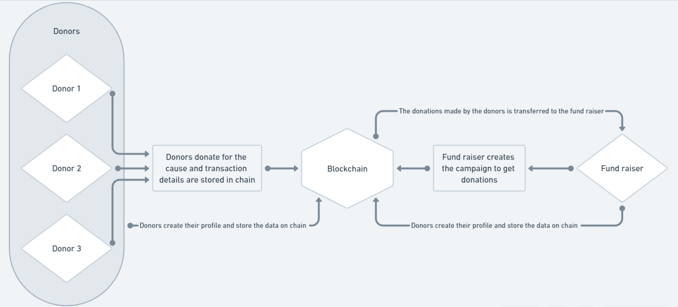
HOMECODERZ
Process Flow

Slide 5




HOMECODERZ
TECH STACK
01
ReactJS
Polygon Chain
Solidity
IPFS

Slide 6


HOMECODERZ
The Landing Page
Detailed View

Slide 7

HOMECODERZ
What are the problems
Enhanced Transparency through Blockchain:
Building Trust through Verification:
Cost-Effective Blockchain Transactions:
Implement blockchain technology to ensure transparent and tamper-proof records of all transactions, providing donors with a clear view of where their contributions are utilized.
Implement robust verification processes for campaigns and organizations to build trust between donors and campaigners, ensuring the legitimacy of fundraising efforts.
Leverage blockchain technology to reduce transaction costs and eliminate the need for intermediaries, ensuring that a higher percentage of each donation goes directly to the cause.

Slide 8
HOMECODERZ
How we solve
Enhanced Transparency through Blockchain:
Building Trust through Verification:
01
02
Implement blockchain technology to ensure transparent and tamper-proof records of all transactions, providing donors with a clear view of where their contributions are utilized.
Implement robust verification processes for campaigns and organizations to build trust between donors and campaigners, ensuring the legitimacy of fundraising efforts.
Cost-Effective Blockchain Transactions:
Enhanced Security Measures:
03
04
Leverage blockchain technology to reduce transaction costs and eliminate the need for intermediaries, ensuring that a higher percentage of each donation goes directly to the cause.
Prioritize the security of online transactions by incorporating advanced encryption and cybersecurity measures, addressing concerns about the safety of financial transactions and personal data.

Slide 9

HOMECODERZ
Campaigns Page

Slide 10
HOMECODERZ
Why use ‘Spark Aid’?
Transparency:
Efficiency:
Security with Blockchain:
Cost-Effective Transactions:
SparkAid leverages blockchain technology, ensuring transparency in every transaction. Donors can trace their contributions, fostering trust in the fundraising process.
SparkAid streamlines the fundraising process, providing an efficient platform for campaigners to list their causes and for donors to contribute seamlessly.
SparkAid integrates blockchain technology for secure transactions, eliminating concerns about data breaches or fraudulent activities during the donation process.
SparkAid leverages blockchain to minimize transaction costs, ensuring that a significant portion of every donation directly contributes to the cause without unnecessary fees.

Slide 11
HOMECODERZ
Future Plans:
Technology Advancements:
Partnerships and Collaborations:
01
02
As technology continues to advance, SparkAid can leverage emerging technologies to enhance its platform further. Integration with new technologies, such as AI and advanced analytics, can provide more personalized and impactful giving experiences.
Collaborations with other platforms, financial institutions, and tech companies can open new avenues for SparkAid. Partnerships can bring in expertise, resources, and a wider user base, contributing to the platform's growth and influence.

